Slide 1
Introduction To PHP

Slide 2
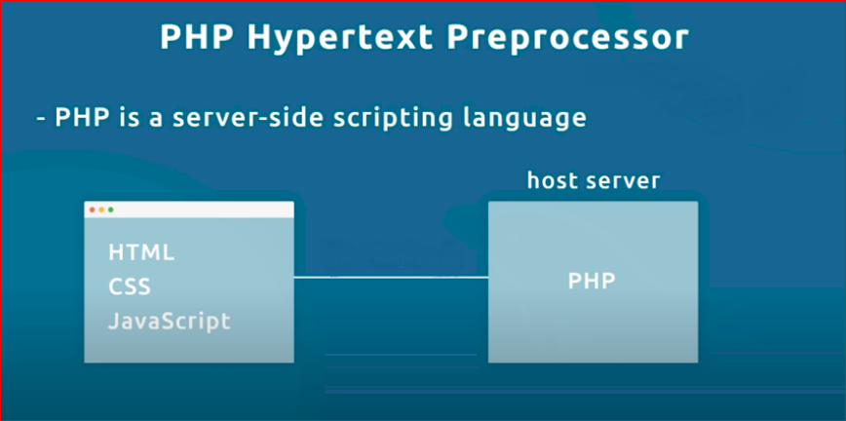

Slide 3
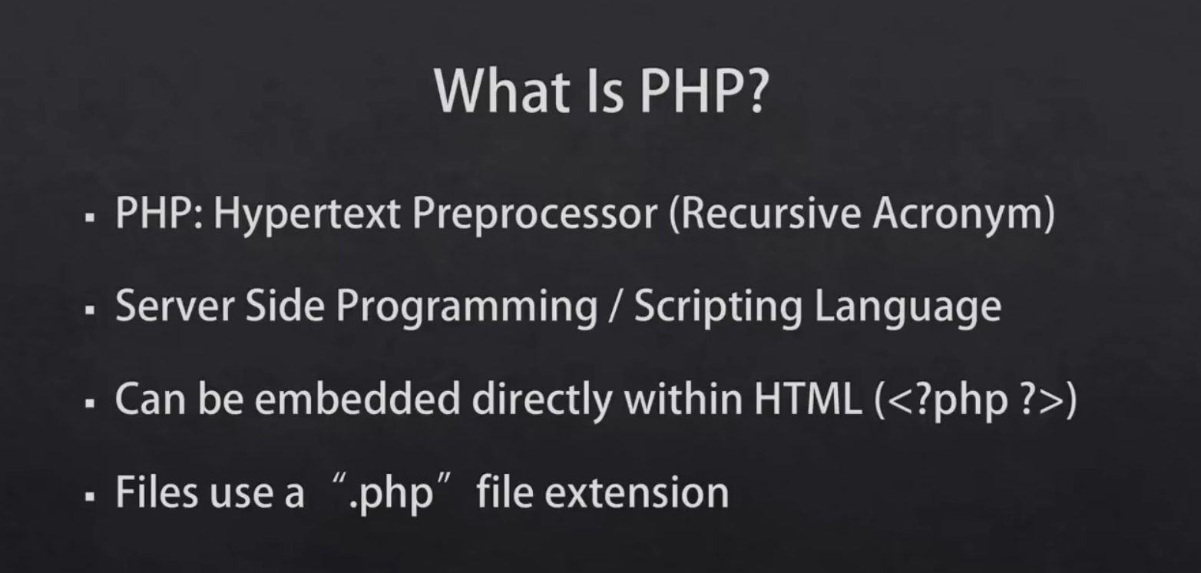

Slide 4
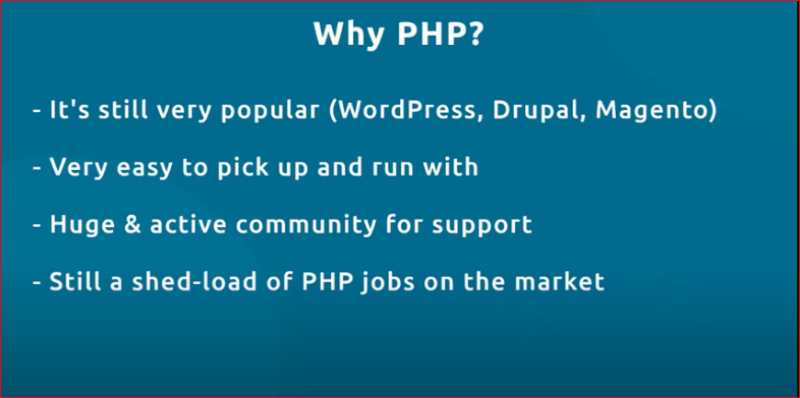

Slide 5
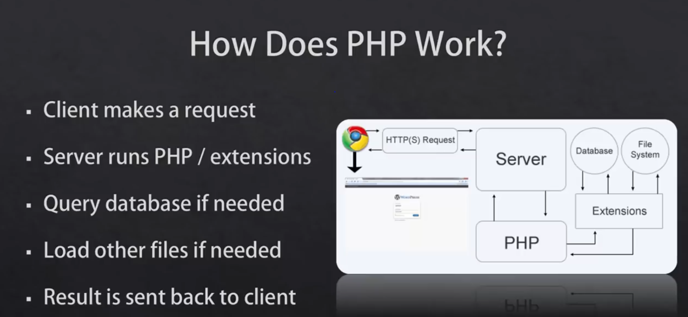
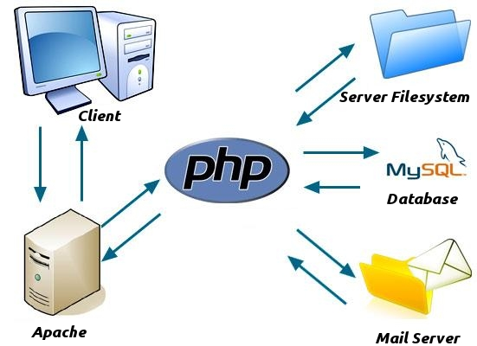

Slide 6
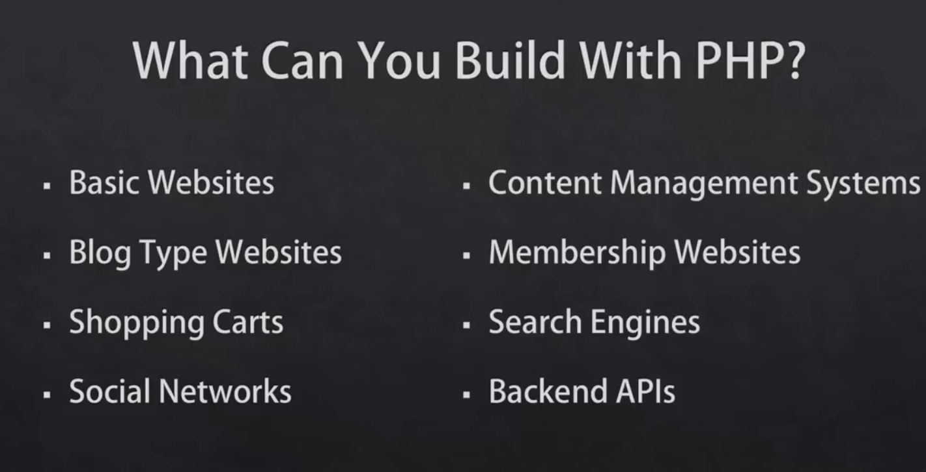

Slide 7
Context:
Installing
PHP basics Principles
Code Syntax (vars, arrays, loops, conditionals, functions)
Database (sql vs no sql) (new module)
Sql (new module)
PHP / Apache / MySQL Setup
Dynamics Pages (back to PHP)
PHP Forms (CRUD)
Working with Databases
Project (New module)
Session cookies api models and other concepts

Slide 8
We will use
2 Layer architecture
Mysqli db connection

Slide 9
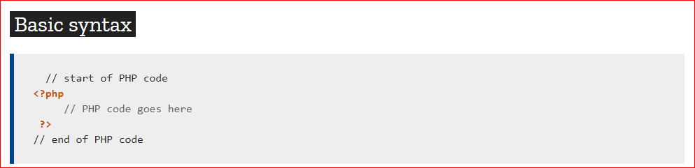

Slide 10
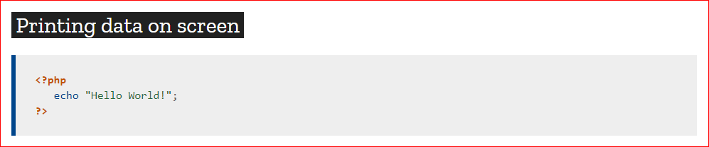

Slide 11
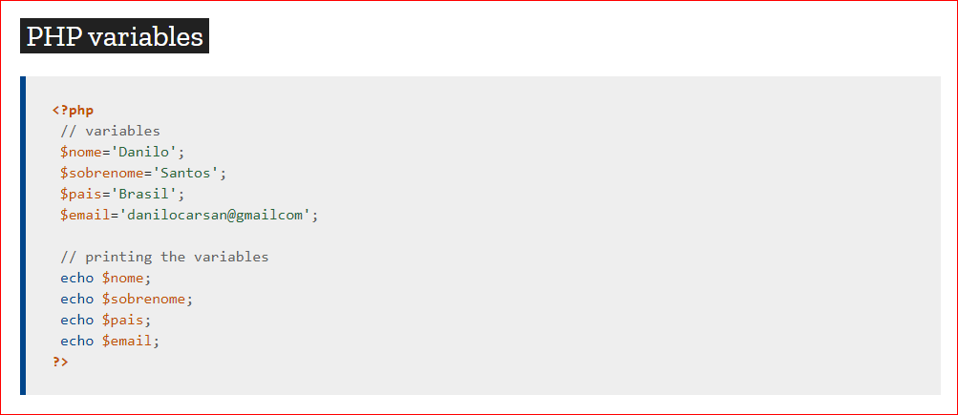

Slide 12
After PHP
OOPs(Object oriented Programming) PHP
3layer architecture
PDO (PHP data types) database connection
Laravel

